Slide 1
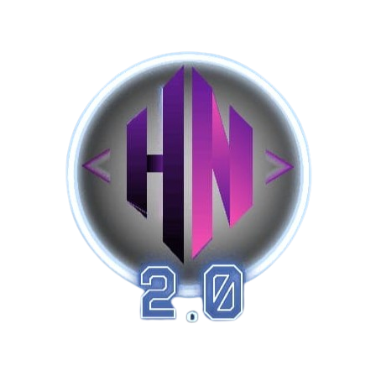
Hack-Nocturne '26
Through the night Ideas take flight

Slide 2



Your Idea
Traditional cybersecurity reacts. Modern phishing adapts in real-time.
PhishFree Real-Time Multi-Modal AI Phishing Detection & Prevention
Problem
Our Solution
Real-Time Multi-Modal Phishing Detection
A browser extension that analyzes every webpage using:
LLM → Detects social engineering & malicious intent
CNN → Identifies fake login page cloning
GNN → Maps suspicious domain networks
Multi-model risk fusion for high accuracy
Explainable threat breakdown for user trust
Blockchain-backed tamper-proof verification logs
The Web is No Longer Human - It’s AI vs AI
Phishing has evolved into AI-generated, hyper-personalized attacks that bypass traditional filters.
Zero-day domains and fast-flux infrastructure render blacklist-based detection obsolete.
Attackers replicate pixel-perfect login pages, defeating text-only scanners.
Users are forced to trust “red/green warnings” without understanding why a site is dangerous.
Enterprises lack tamper-proof forensic trails for post-attack investigation.
What Makes It Unique
True multi-modal AI (Text + Visual + Domain Graph)
Live detection before credential submission
Explainable threat breakdown
On-chain verification for forensic trust

Slide 3
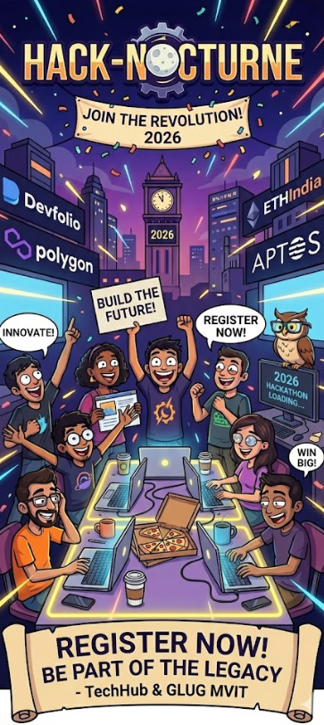
Why should we select you?
We are highly interested in addressing real-world cybersecurity challenges, particularly in addressing phishing attacks caused by AI-based phishing attacks.
We are aware of how to design multi-layered systems, including how to incorporate AI models, backend APIs, browser integrations, and security considerations.
We are interested in building a scalable and interpretable phishing detection system, not just a classifier.
We are interested in exploring how multi-modal AI can greatly benefit the accuracy of phishing attacks.
This hackathon is a great opportunity to test our concept in a competitive environment.
We are highly interested in building a technically robust and feasible system.
Hack Nocturne gives us the perfect stage to transform this research-driven concept into a real-world cybersecurity solution.

Slide 4





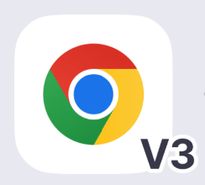

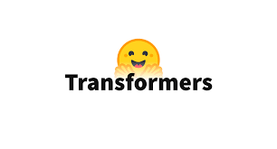



Tech-Stack & Platforms You Mostly Build On
Frontend / Backend
AI & ML Stack
Frontend
HTML
JavaScript
Tailwind CSS
Chrome Extension (Manifest V3)
Backend
Python 3.10
Flask REST API
Flask-CORS
Modular ML inference pipeline
PyTorch
HuggingFace Transformers
RoBERTa (Phishing language detection)
CLIP + MLP Head (Visual spoof detection)
GraphSAGE(Domain relationship modelling)
PyTorch Geometric
LightGBM (Ensemble risk scoring)
Cloud / DevOps / Tools
Blockchain & Web3 / Cybersecurity
Docker & Docker Compose
GitHub
REST API architecture
Rate limiting & logging
CSV report export
Wev3.py
Ethereum Sepolia Testnet
Immutable analysis anchoring
Domain intelligence modelling
Risk scoring engine
Leave fields blank where not applicable, you can put logos of tech stacks in the provided space

Slide 5
Thank you
Good Luck 👍
Team Hack-Nocturne
contact@hack-nocturne.in
https://hack-nocturne.in/
Team – Fourage
Member 1 – Siona Raj
Member 2 – Sahil Pradhan
Member 3 – Sohan B
Member 4 – Swaraj Kumar

